Slide 1
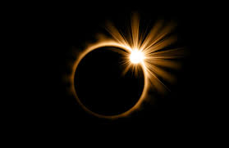
Gravity Waves Analysis Tool
By Thomas Marten, Duncan Zaug, Justyce Countryman, Tim Dube, Daniel Maslowski
Notes:
-Daniel

Slide 2
Our Vision Statement
For individuals with at least a sophomore-level education in atmospheric sciences or physics who would like to view the effects of gravity waves in radiosonde data
Easy to use UI with no installation or programming required
Output graphs and gravity wave parameters in one PDF
Completely free and open source, unlike IDL
Notes:
-Thomas

Slide 3
What Our Software Accomplishes
Parses any radiosonde data with the standard format where the line of variables is the first line under “Profile Data:”, followed by the units, then the data
Also parses the V2 and V3 data
Robust in handling some un-QC’d data (like data collected after the balloon popped or small sections of missing data)
Gives users option to preview and download data in a PDF
17 graphs in total in the PDF
Only user requirement is internet connection
Notes:
-Thomas

Slide 4
All Graphs
Troposphere
Stratosphere
Temperature with altitude
U wind component with altitude
V wind component with altitude
Temperature perturbation
U wind component perturbation
V wind component perturbation
Hodograph
Ascension rate
Temperature with altitude
U wind component with altitude
V wind component with altitude
Temperature perturbation
U wind component perturbation
V wind component perturbation
Hodograph
Ascension rate
Dr. Barber’s Weather Balloon Path Graph
Notes:
-Daniel

Slide 5
Several Challenges & Solutions
Challenge 1: Get variables and units from radiosondes since there are so many different formats (some variables missing or in different order while some radiosondes like the QC’d files have no units).
Old Solution: Originally hard code formats into program.
New solution: Dynamically parse line of variables right under “Profile Data:” and then parse units. Issue arose of variables with two words like “Virt. Temp” though special cases were created to handle them. Also hard coded units for QC’d files since they didn’t have any
Notes:
-Daniel

Slide 6
Challenges & Solutions
Challenge 2: Validate graphs and output
Solution: Use degree of 3 for polynomial (from GDL code) and for tropopause, calculate lapse rate of 1.5°C/km and do not take values less than 5.5km.
Future Plan: Take into account thickness of tropopause to further remove background noise
Notes:
-Justyce
During the calculation that approximates where the tropopause is using a gradient, we only consider data lines with an altitude of 5500m or higher. From that data, we look for the first line of data that has a lapse rate of less than 1.5 degrees Celsius/km. That is what we consider the minimum altitude.
rs

Slide 7
Challenges & Solutions
Challenge 3: Backend limiting number of users and security (One user at a time can upload)
Solution: In progress
Future Plan:
Implement user session management in Flask to differentiate between users (each user's uploads and outputs can be handled separately)
Modify the upload and output directories to be unique per session
Clear session-specific folders so the folder clearing functions are updated to only clear files related to the user's session
Modify the PDF retrieval endpoint to only access the PDFs from the user's session-specific output folder
Will use environmental variables for password (instead of hard coding)
Notes:
-Duncan

Slide 8
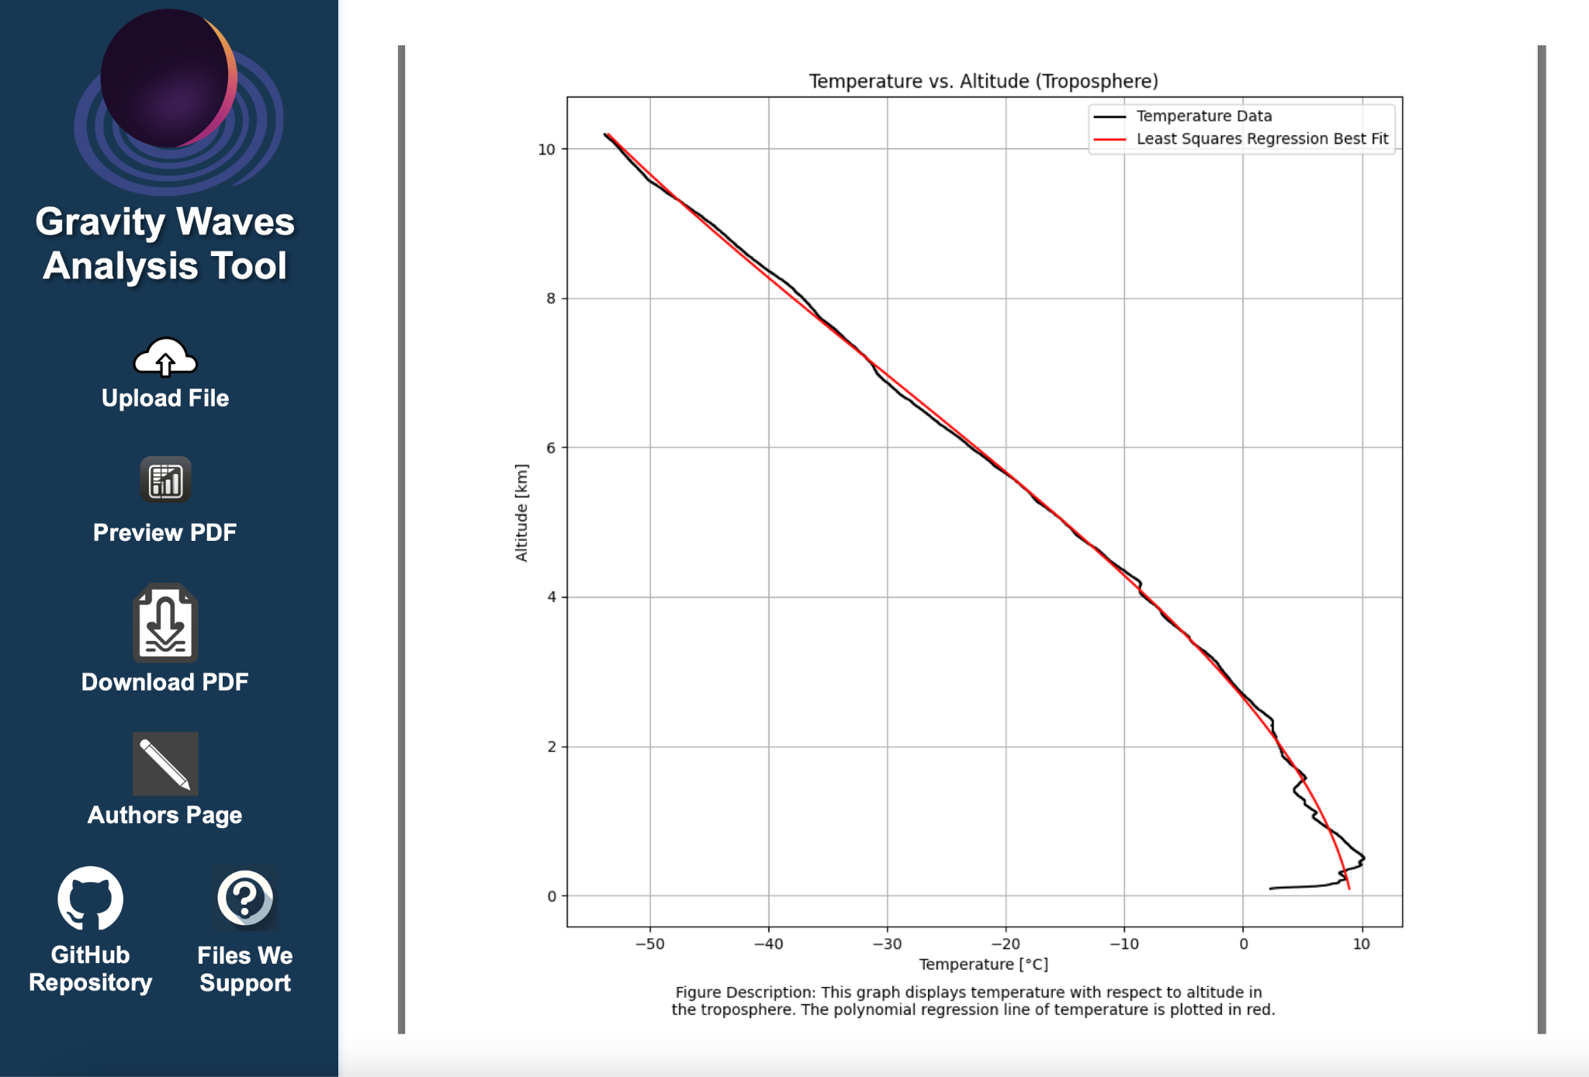
Final Product UI
Notes:
-Daniel

Slide 9
Future of GWAT
The official deadline Dr. Tenbergen set for making any adjustments to the Software (both stakeholder requests and student modifications) was April 20th
We would like to continue working with you over the summer to get it fully functional
Finals week is next week

Slide 10
Thank you very much Dr. Gong, Dr. Kanbur, and Dr. Barber

Slide 11

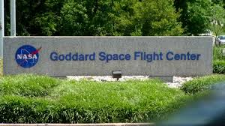

Key Stakeholders
Stakeholders: Dr. Gong, Dr. Kanbur, Dr. Barber, Dr. Tenbergen
NASA Goddard Space Center
Suny Oswego Physics Department
The Atmospheric and Geological Sciences Department
Notes:
Who are the stakeholders

Slide 12
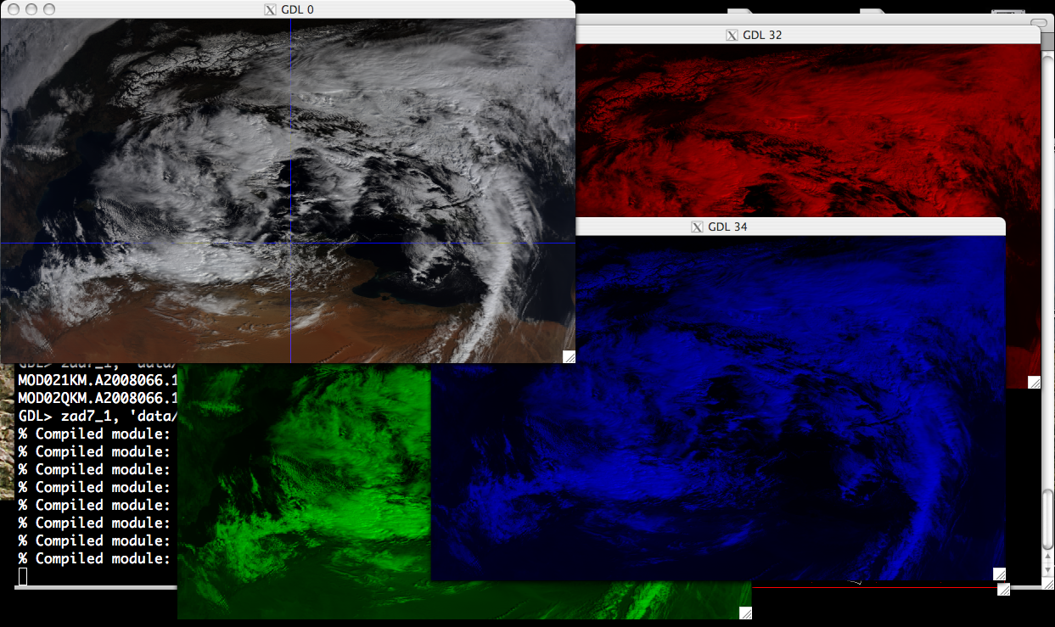
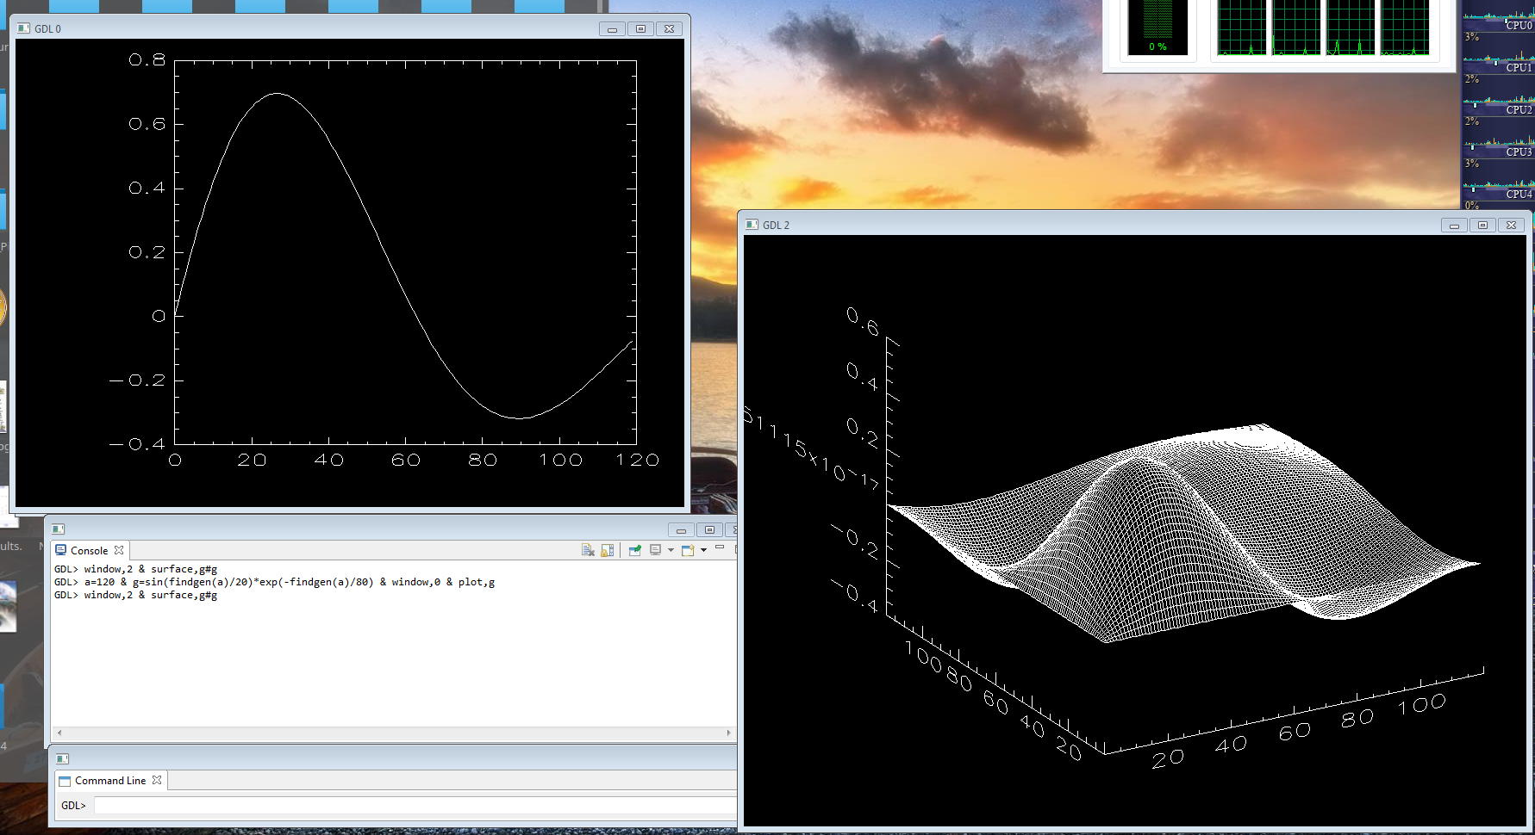
Why this Program?
Easy access to IDL/GDL
Unbelievable data analysis capabilities
For learners and professionals studying:
Meteorology, Atmospheric/Geological Sciences, Physics
Converts a text file with radiosonde (weather balloon) data into several visual graphs
Better for data relationship analysis
Integrated into a web application
Notes:
-sell / pitch of the proejct
IDL - Proprietary (Requires an expensive license) -> We used the open-source version
GDL - Open Source (Does not have as many features as IDL)
These restrictions helped with the decision of making a web application

Slide 13
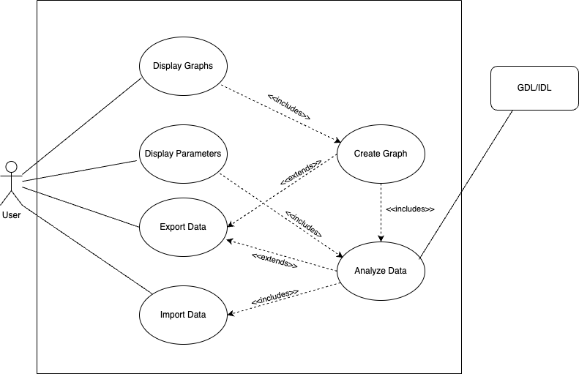
Method Behind the Madness
Notes:
High Level conceptual model

Slide 14
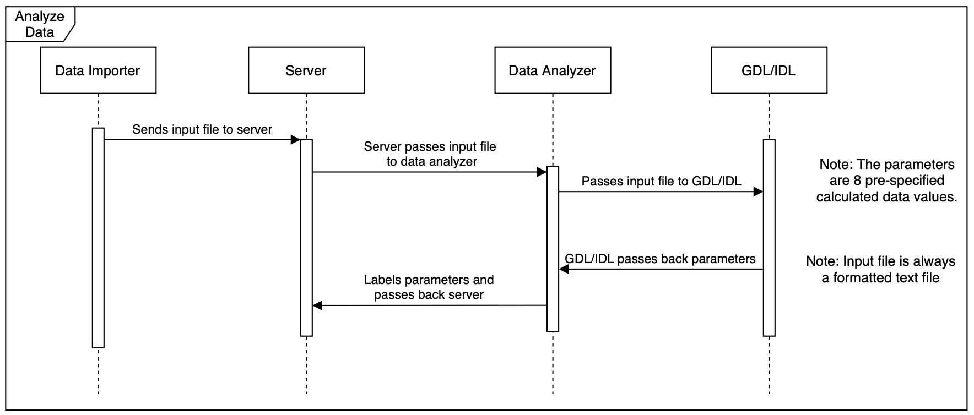
Notes:
Pong (program returning the data)

Slide 15
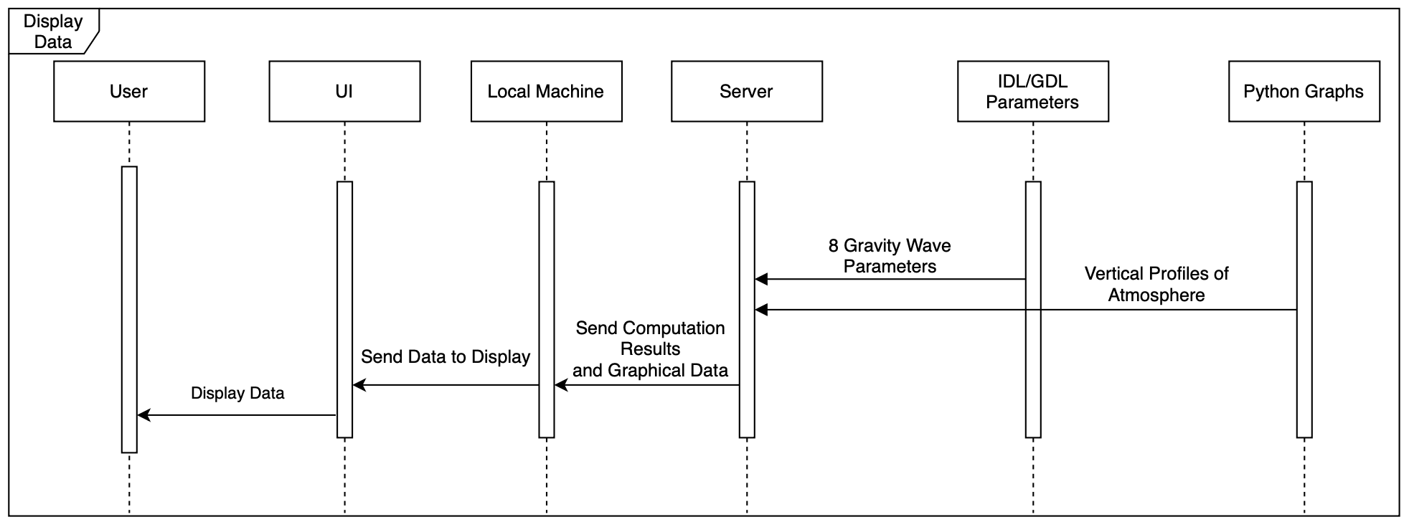
Notes:
Ping (user doing stuff)

Slide 16
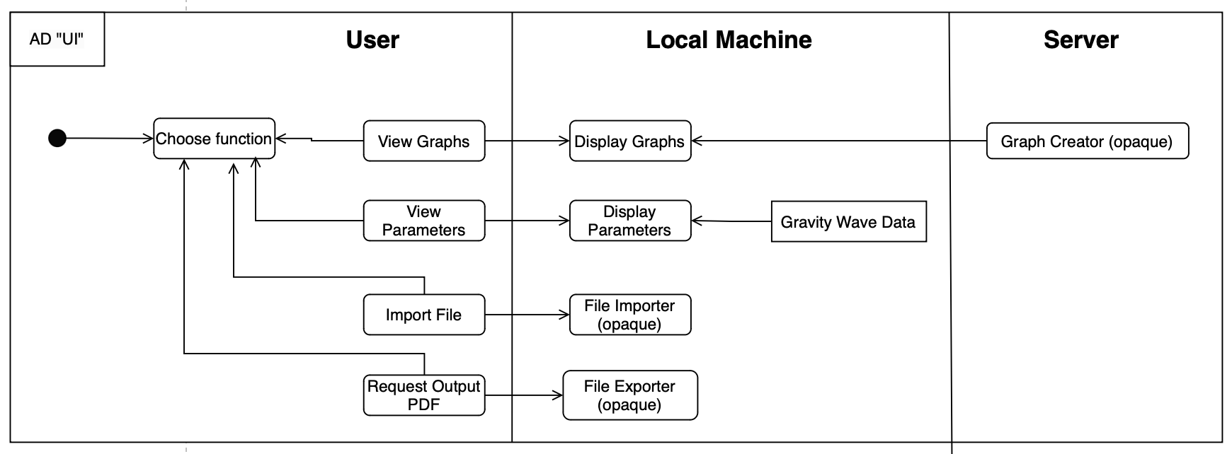
Notes:
Front End

Slide 17
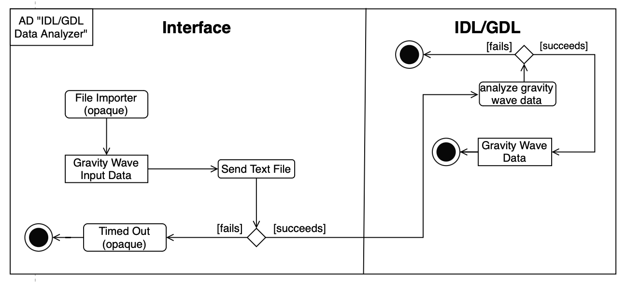
Notes:
BackEnd

Slide 18
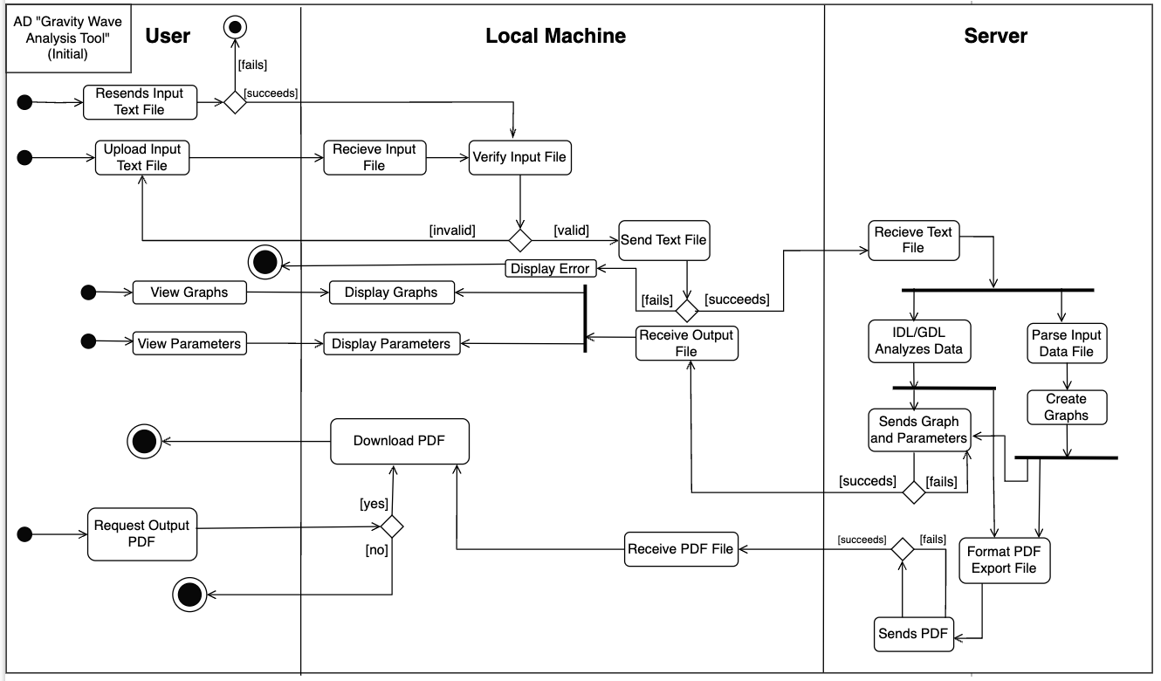
Notes:
Here it is put all together

Slide 19
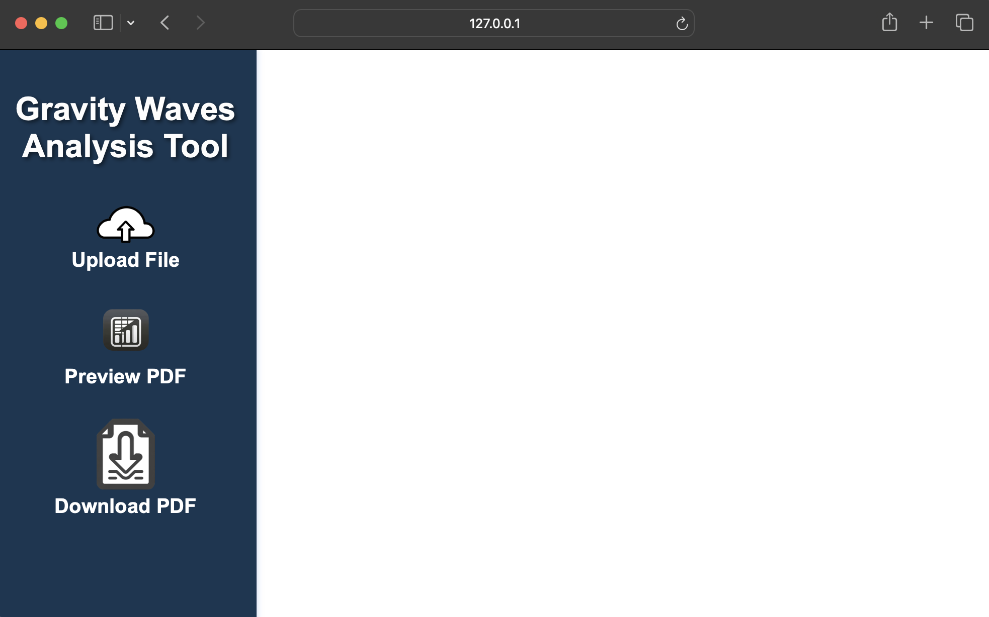
Ingredients to the Recipe
Defining requirements and use cases
What does the user need to do in order to get the expected output?
Website for easy access
Developed with a straightforward, “click-and-forget,” UI
Easy deployment
Backend code - Python
Frontend code - HTML, CSS, and JavaScript
Combined together with Flask and deployed with Docker
Common graphs
Variables for troposphere and stratosphere: Temperature, altitude, wind components, and ascension rate
Analyzed data
Latitude and longitude, tropopause altitude, wavelength, energy, intrinsic frequency, and many more
Notes:
-key design choices made
Docker - Utilizes a dockerfile and two images to run the backend code from the server and the user just needs to enter one command to run the web app
Flask - Connects the backend and frontend code together

Slide 20
Github/User Guide
Notes:
-show the dang thing working

Slide 21
DEMO
Notes:
-show the dang thing working

Slide 22
References
What are gravitational waves?. LIGO Caltech. (n.d.). https://www.ligo.caltech.edu/page/what-are-gw
Gong, J. (2022, October 26). NEBP atmospheric science: Atmospheric gravity waves, part 1. YouTube. https://www.youtube.com/watch?v=nPgnCaf9Jk8
Moran, David (Jan 24, 2018).Transverse and longitudinal waves review. National Weather Service. (n.d.). https://www.weather.gov/source/zhu/ZHU_Training_Page/Miscellaneous/gravity_wave/gravity_wave.html#:~:text=In%20a%20gravity%20wave%2C%20the%20upward%20moving%20region%20is%20the,stable%20layer%20of%20the%20atmosphere.
The GDL Team. (2023, September 8). GDL - GNU Data Language. gnudatalanguage.github.io. https://gnudatalanguage.github.io/index.html
https://en.m.wikipedia.org/wiki/File:NASA_logo.svg
https://svs.gsfc.nasa.gov/10648/
https://ww1.oswego.edu/communications-and-marketing/brand/logos
Notes:
-show the dang thing working

